Slide 1
Project Team
-أحمد محمد محمد مرسي.
-أحمد محمد أحمد محمد حسن.
-أحمد علاء الدين أحمد حسين.
-أحمد محمود محمد شعبان.
-أحمد محمد عارف عبد الرحيم.

Slide 2
Project name:
Faculty System
Section Number:
Two

Slide 3
Project description:
controlling, organizing, and managing time and courses between doctors, teaching assistance, and students to choose the empty stands and laboratories to take lectures and courses.

Slide 4
Project gales:
1) Manage and organize time between doctors and students.
2) This project introduces for student available course in the faculty.
3) It make education process easier for the students.
4) This project presents the places where the courses are taught.
5) This project consists of (tables, query, reports, forms)

Slide 5
Outlines
1) project Relationship(ERD).
2) project Tables.
3) project Queries.
4) project forms.
5) project Reports.

Slide 6
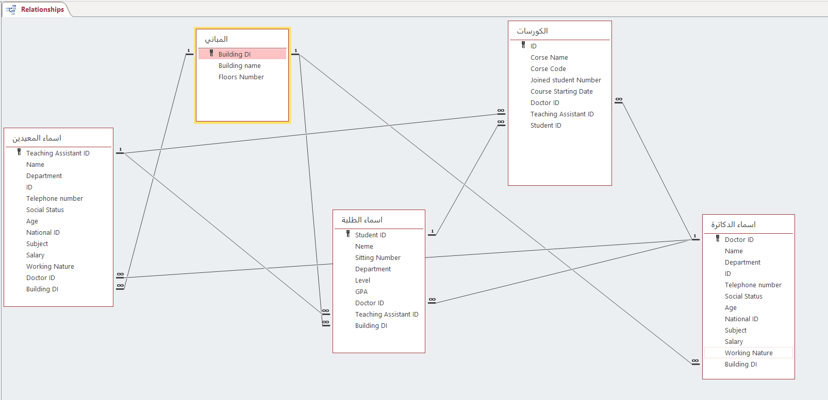
1) Project Relationship:

Slide 7
2) Project tables:

Slide 8
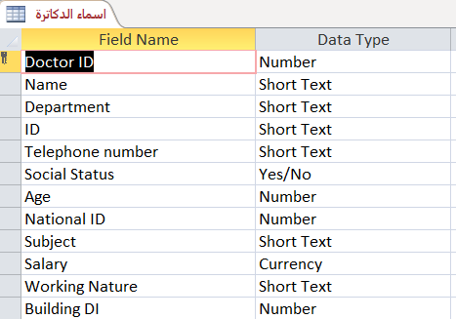
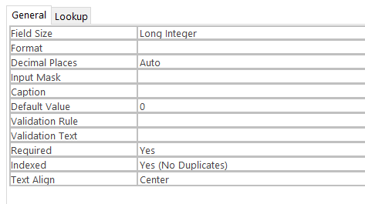
1) Doctor table
*The doctor’s table which has a number of attributes such as :
*(Doctor ID, Name , Department, ID, Telephone number, Social Status, Age , National ID ,Subject , Salary, Working Nature, Building DI) .

Slide 9
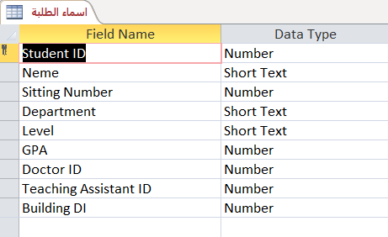
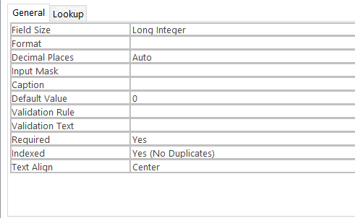
2) Student table
*The Students table which has a number of attributes such as:
*(Student ID, Name, sitting number, Department, level, GPA, Doctor ID, teaching assistant ID, Building ID).

Slide 10
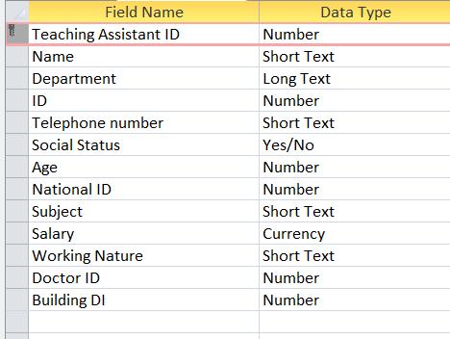
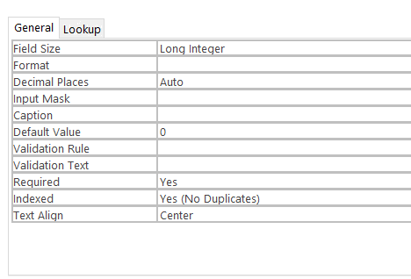
3) Teaching Assistant table
The Teaching assistants table which has a number of attributes such as :
*(teaching assistant ID, Name , Department ,ID , Telephone number, Age , National ID , subject , Salary, Working Nature, Doctor ID, Building ID)

Slide 11
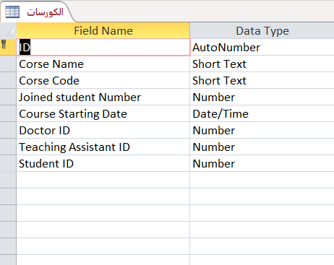
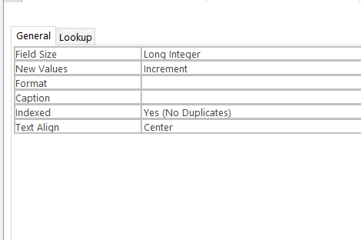
4) Courses table
The Courses table which has a number of attributes such as:
* (ID, course name, course code, joined student number, course starting data, Doctor ID, teaching assistant ID, Student ID )

Slide 12
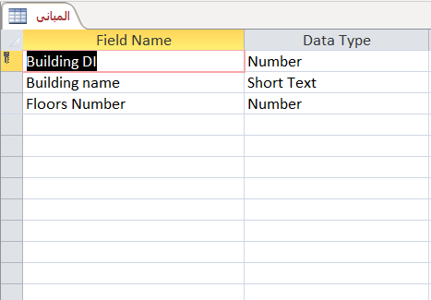

5) Building table
*The building table which has a number of attributes such as :
*(Building DI, Building name, Floors Number).

Slide 13
3) Project Queries:

Slide 14
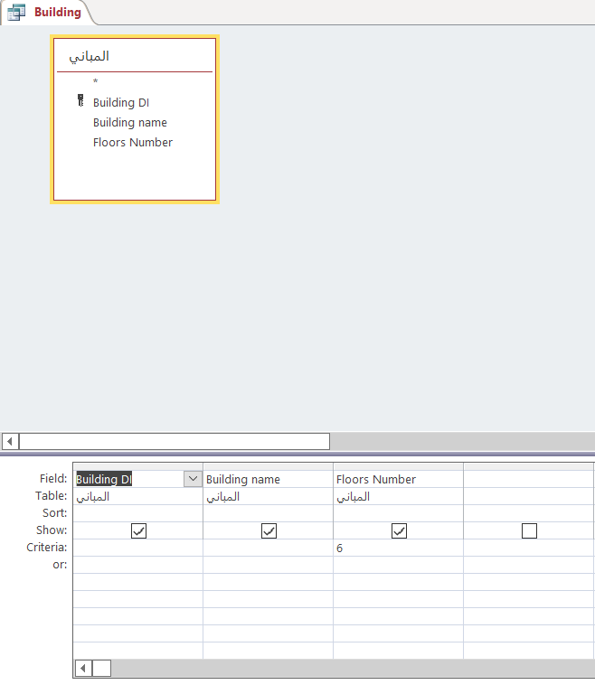
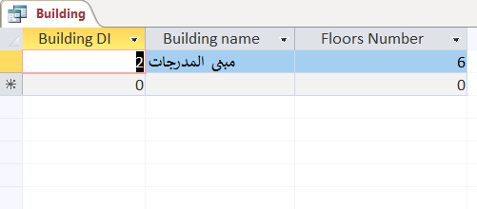
In this query we will show the data about building that includes 6 floors.

Slide 15
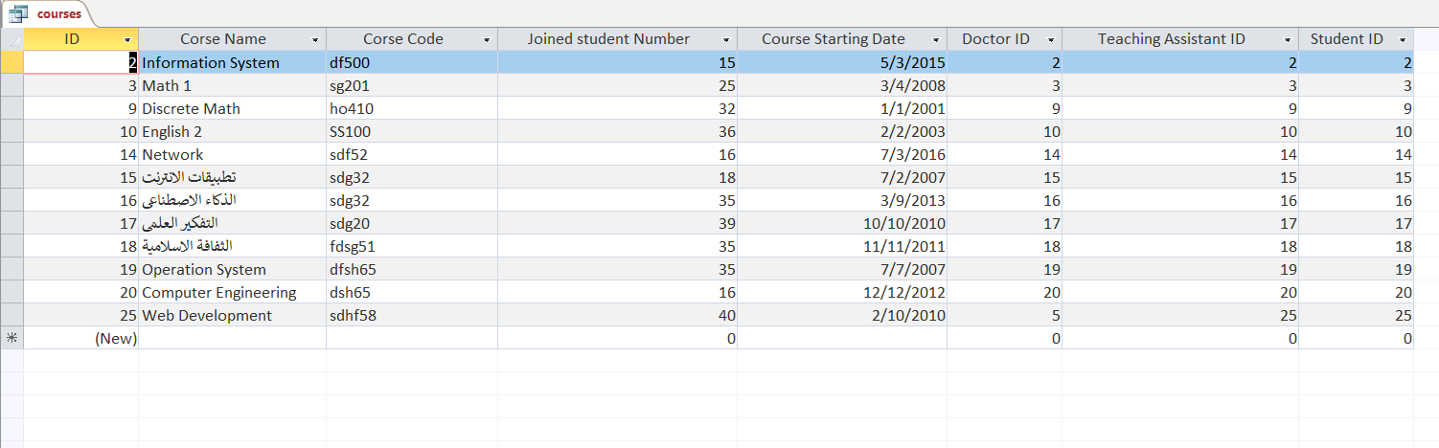
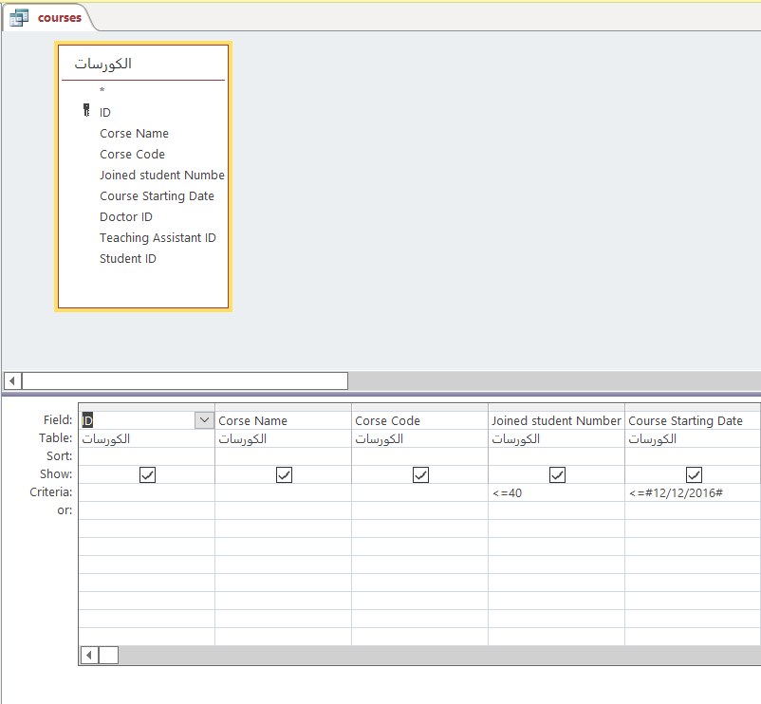
In this query we will show the data about courses that date less than or equal 12/12/2016 and courses less or equal 40.

Slide 16
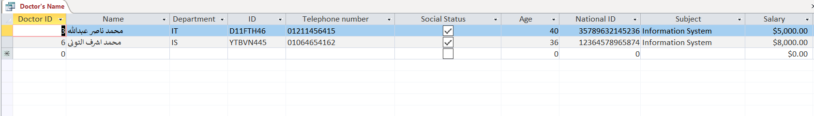
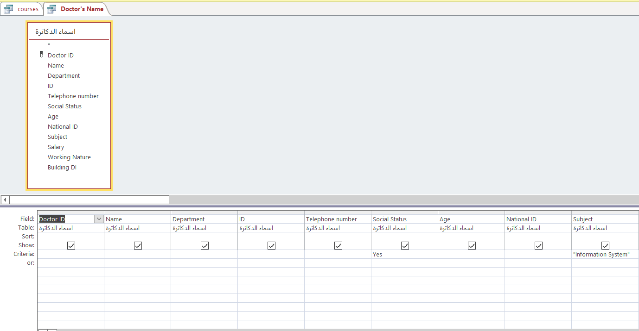
In this query we will show the data about doctors that social status “Yes” and subject “information System”.

Slide 17
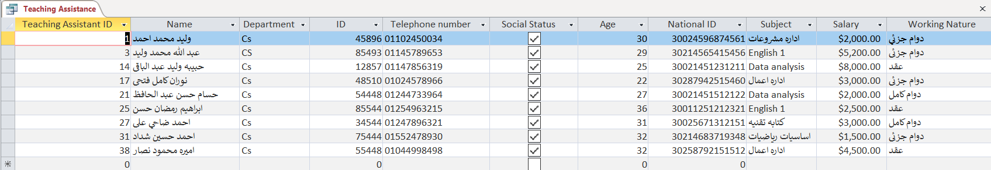
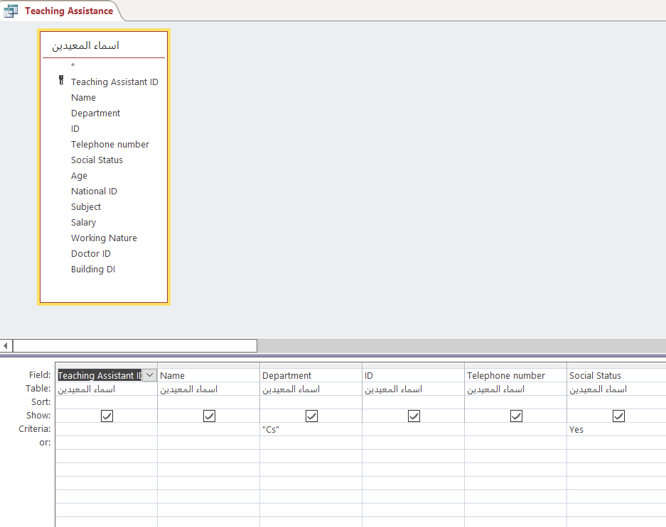
In this query we will show the data about Teaching Assistant that social status “Yes” and department “Cs”.

Slide 18
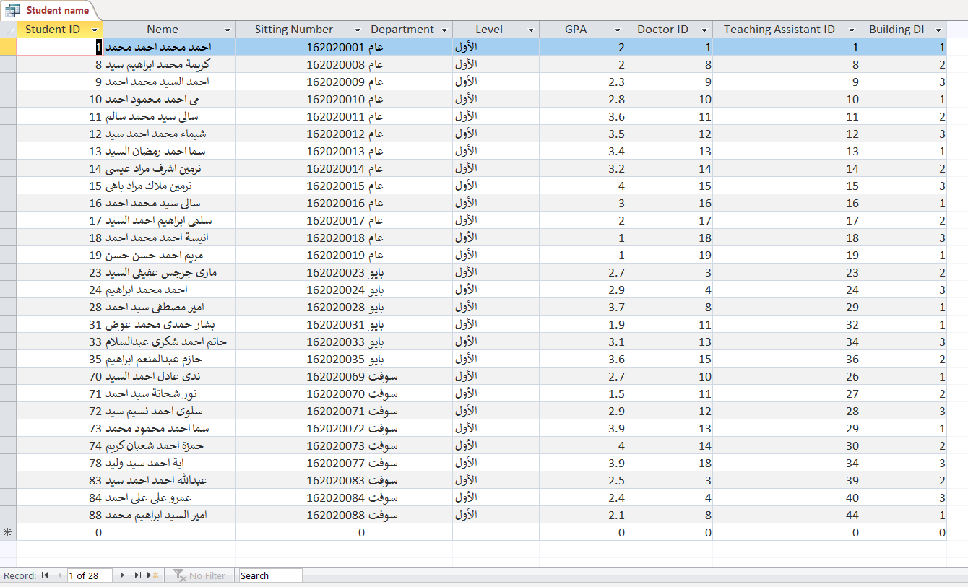
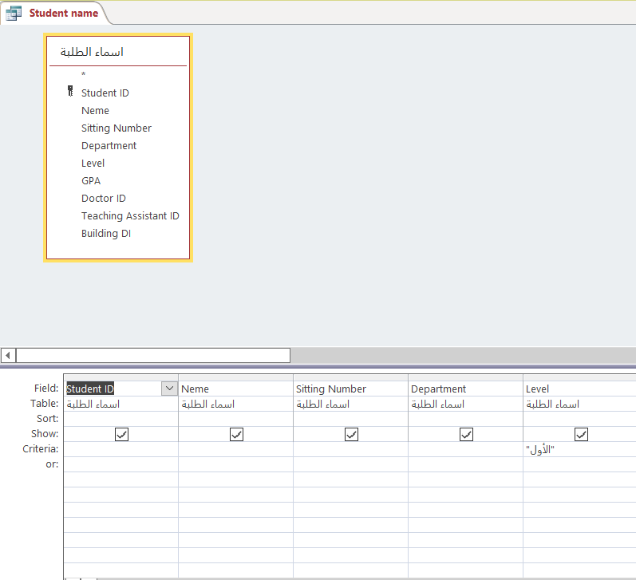
In this query we will show the data about students that social level “الأول”.

Slide 19
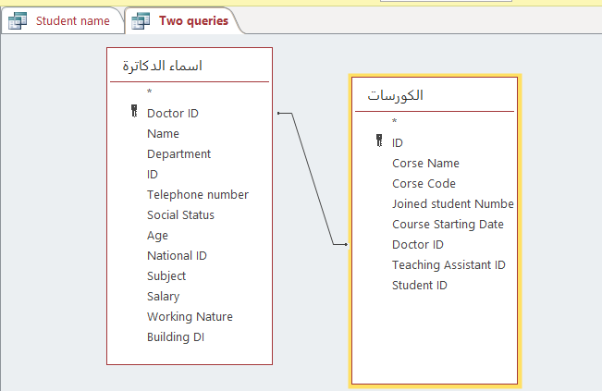
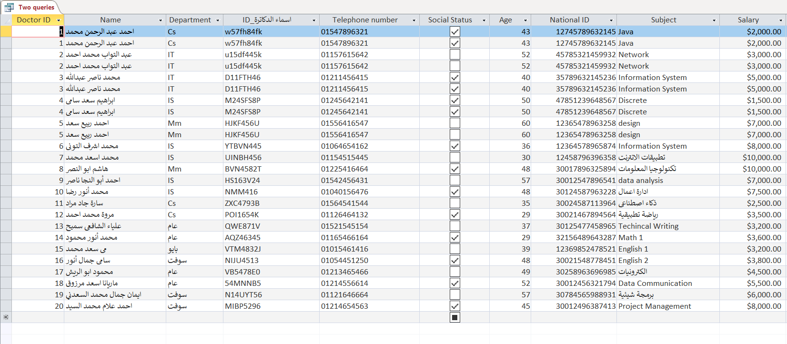

Slide 20
4) Project form:

Slide 21
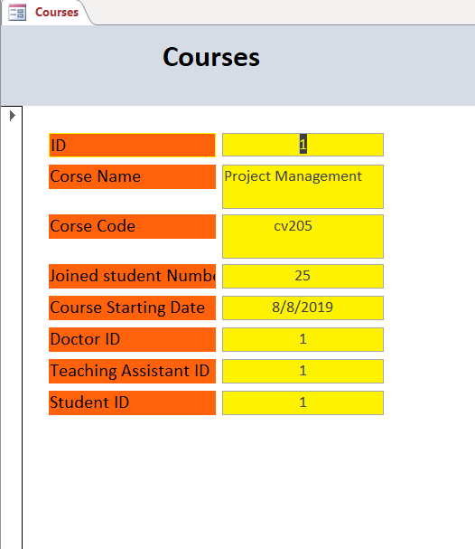
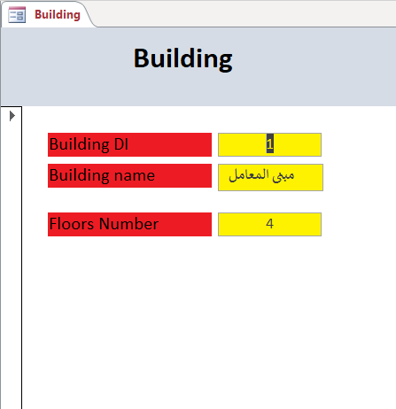

Slide 22
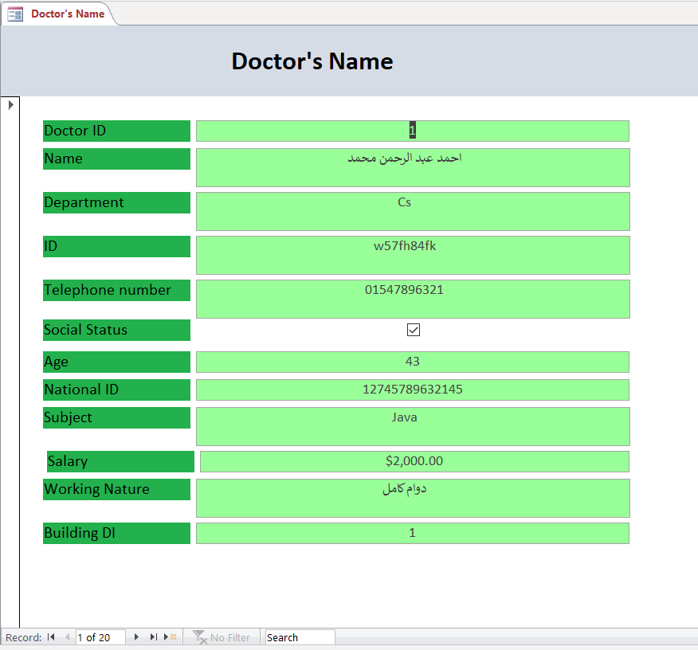

Slide 23
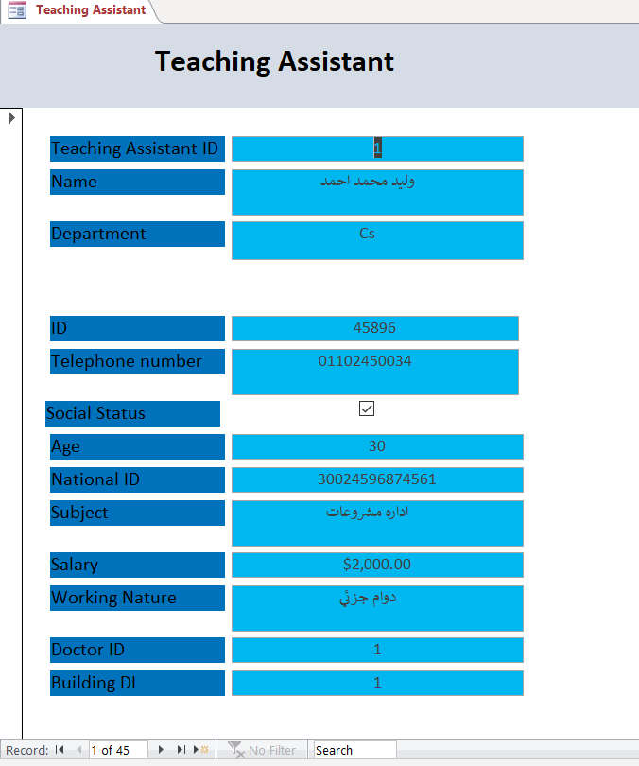
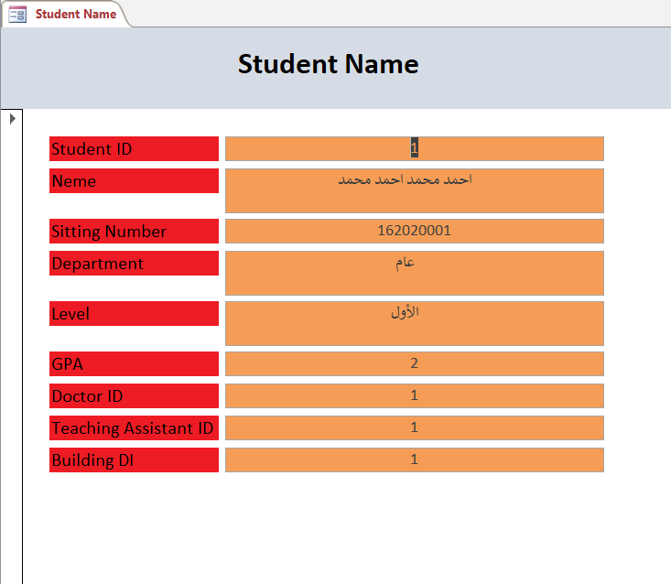

Slide 24
5) Project Report:
In this slides we will show reports about our tables:

Slide 25
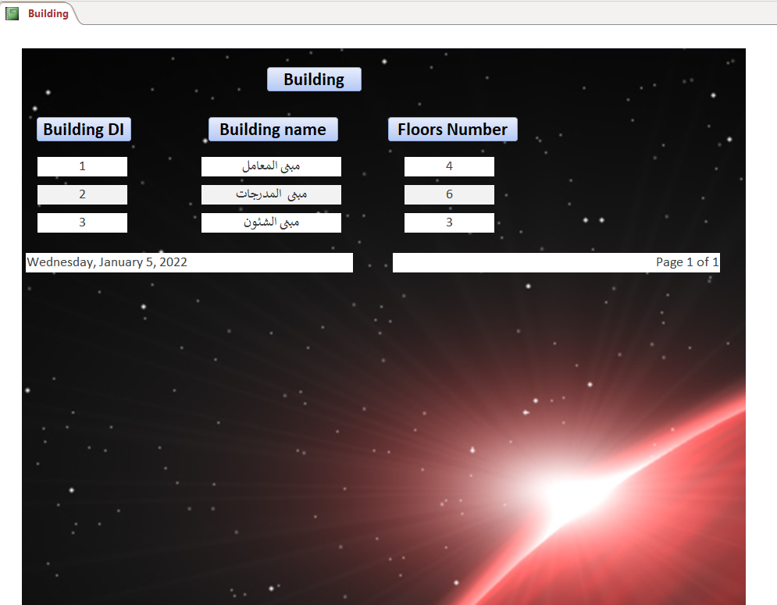
Report about Building to show all details about this table:

Slide 26
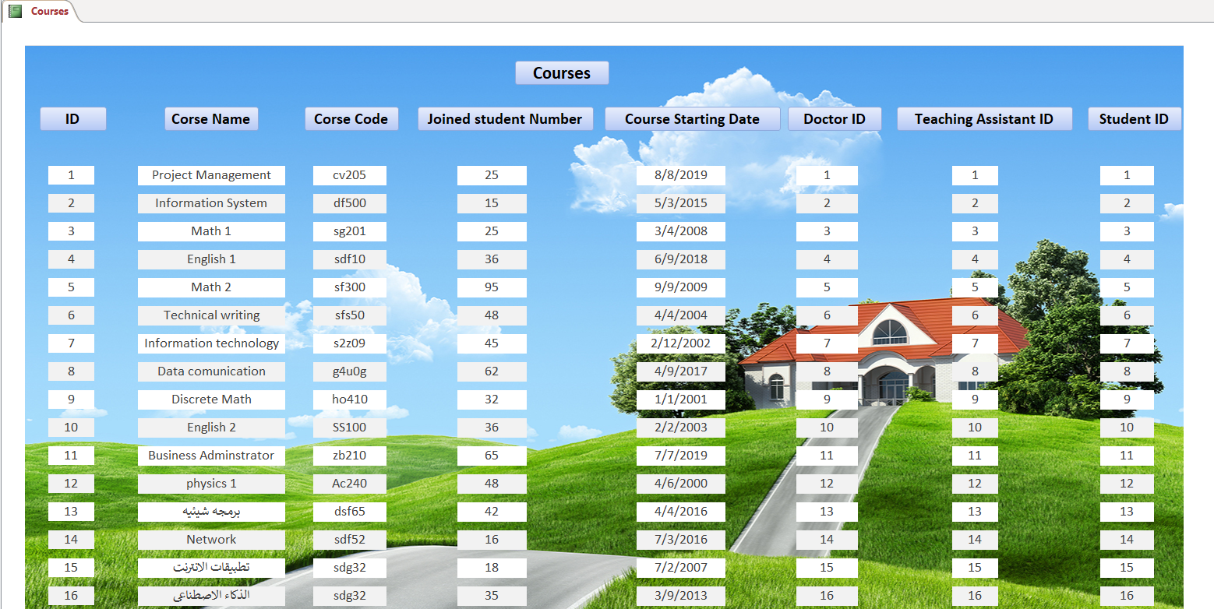
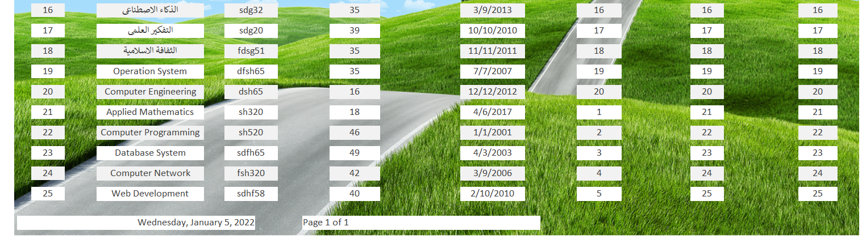
Report about courses to show all details about this table:

Slide 27
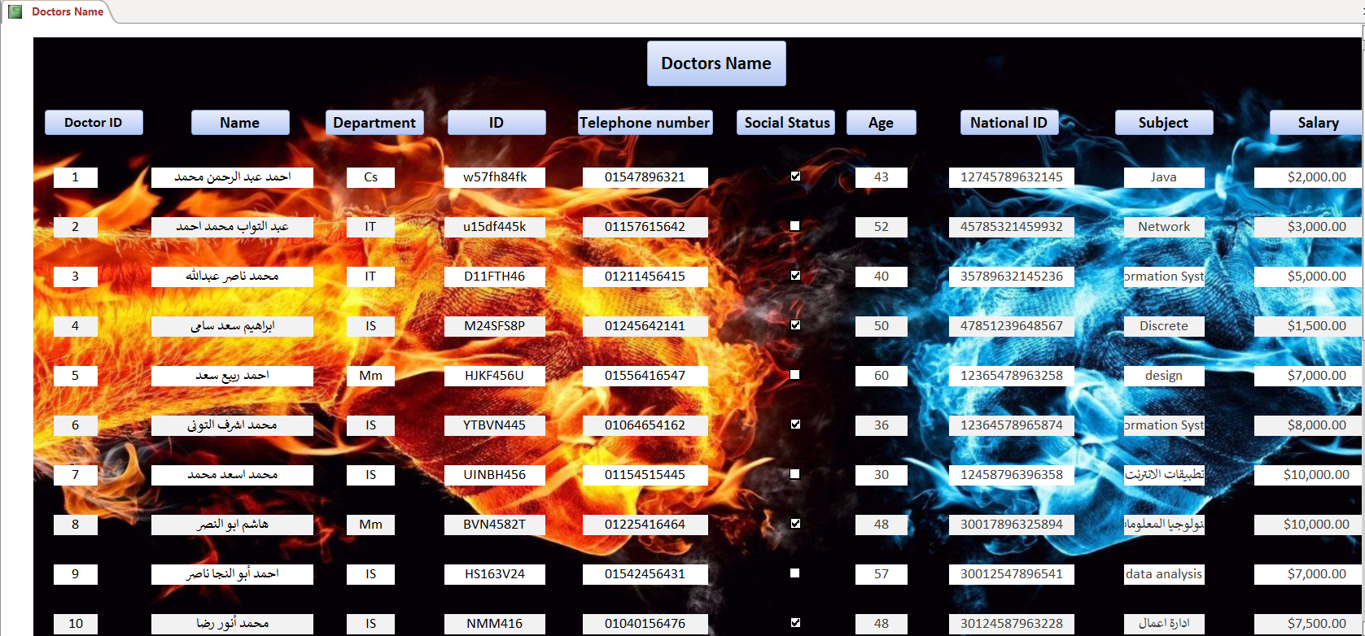
Report about doctor to show all details about this table:

Slide 28
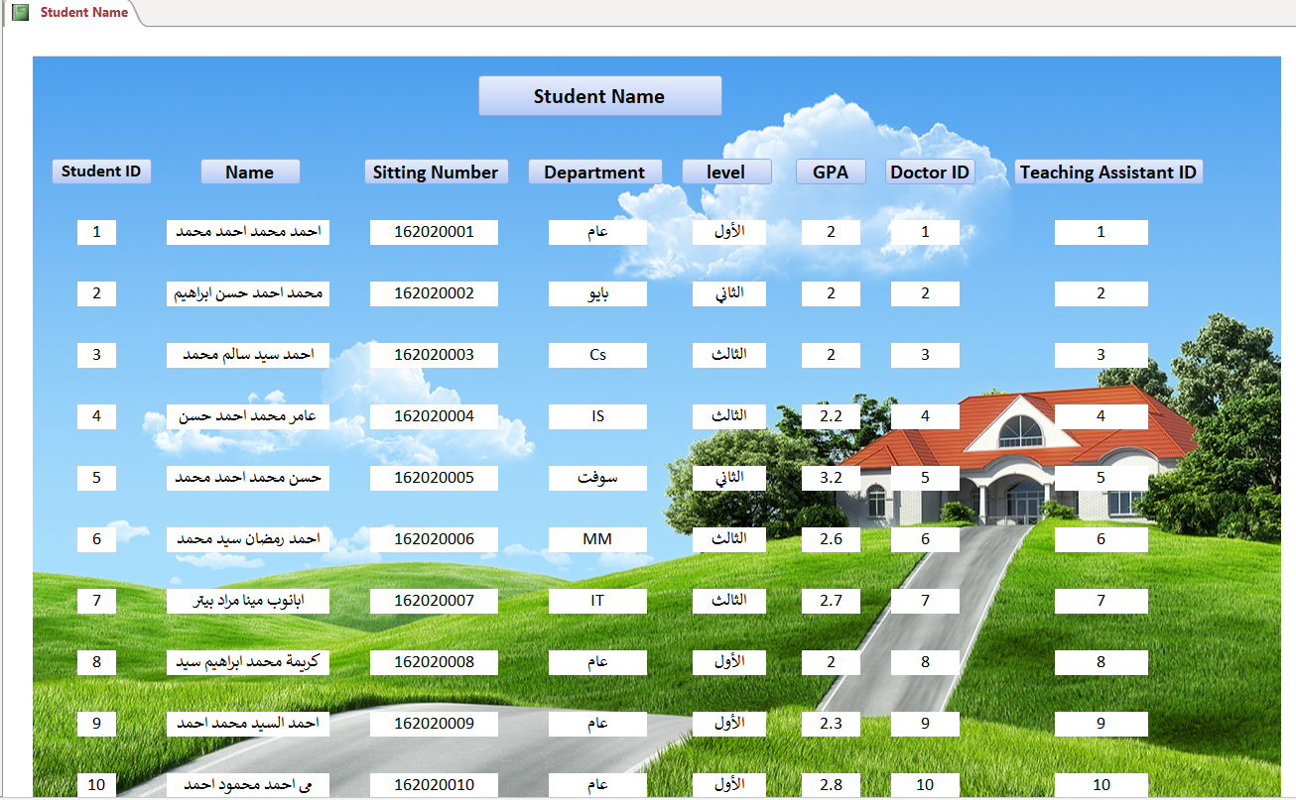
Report about students to show all details about this table:

Slide 29
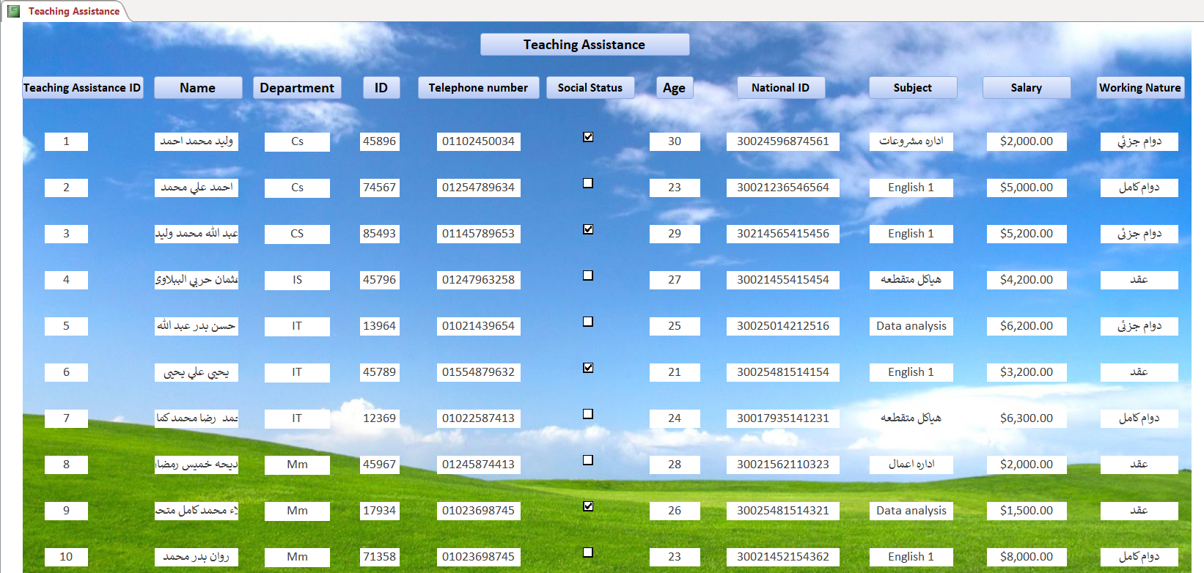
Report about Teaching Assistance to show all details about this table:

